Slide 1
Continuous Integration

Slide 2

Agenda
Why CI ?
What is CI?
Tooling Landscape
Jenkins
Why jenkins
CI with jenkins
Hands on using jenkins

Slide 3





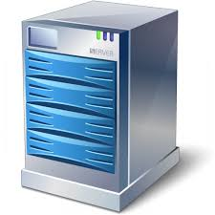






Life without CI
Continuous Push
Tedious Integration
BUGS
Unusual releases
Last minute testing
Notes:
Talk about real life problems:
Talk how things were like on the first day at SD & how the decision to implement CI first hand paid off so well
How in a product based company they are having the agility to perform Functional testing by not writing the functional test case but just writing them
Talk about multi feature development

Slide 4
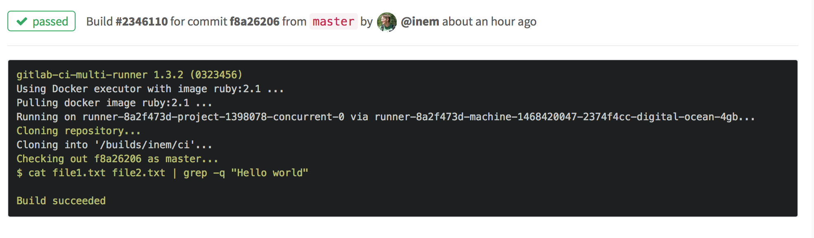
CI Phases : Code Stability
Notes:
What’s the purpose of Code Stability Job
What should be the frequency

Slide 5
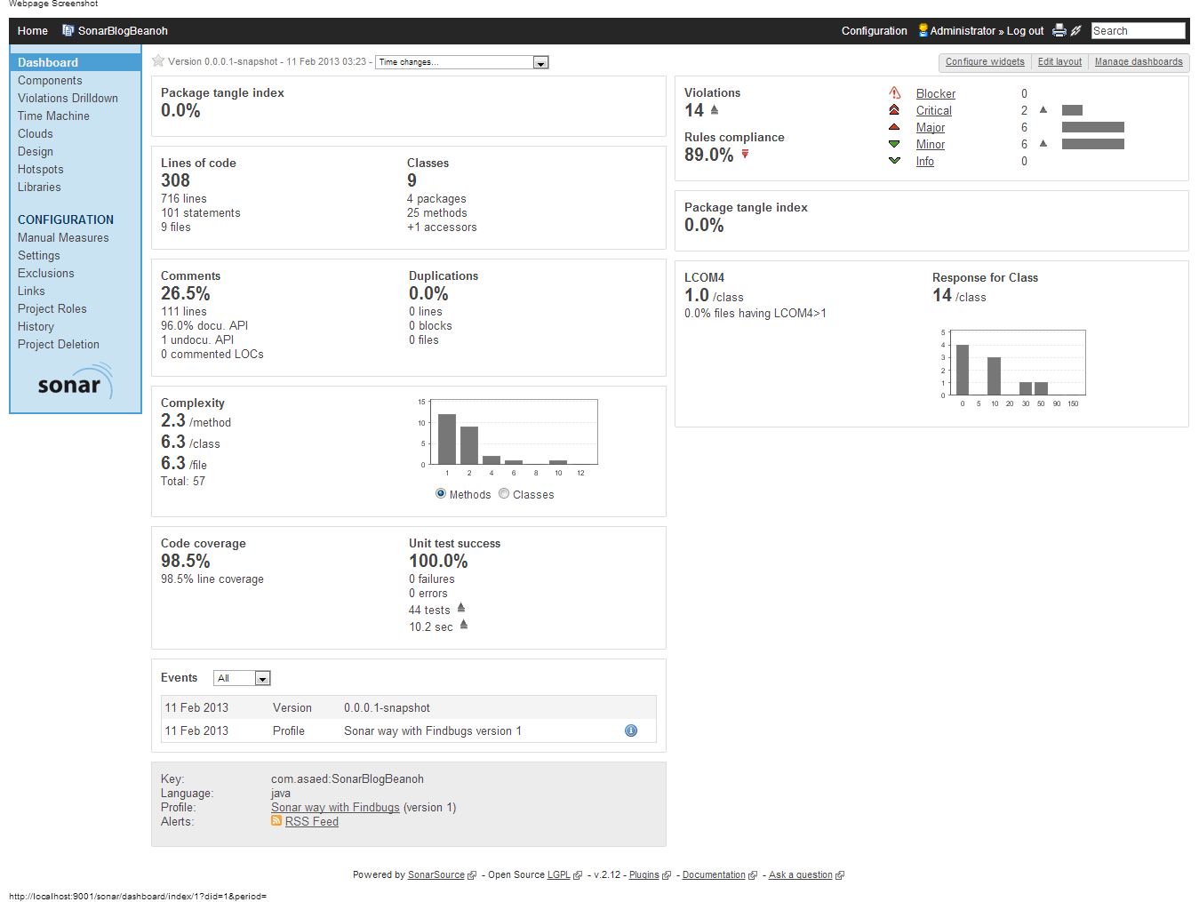
CI Phases | Code Quality
Notes:
Ask people what are common code review output’s
Examples of Code Quality
Naming Convention
Eating exception
Tools : PMD, Checkstyle, Cobertura
Talk about Sonar

Slide 6
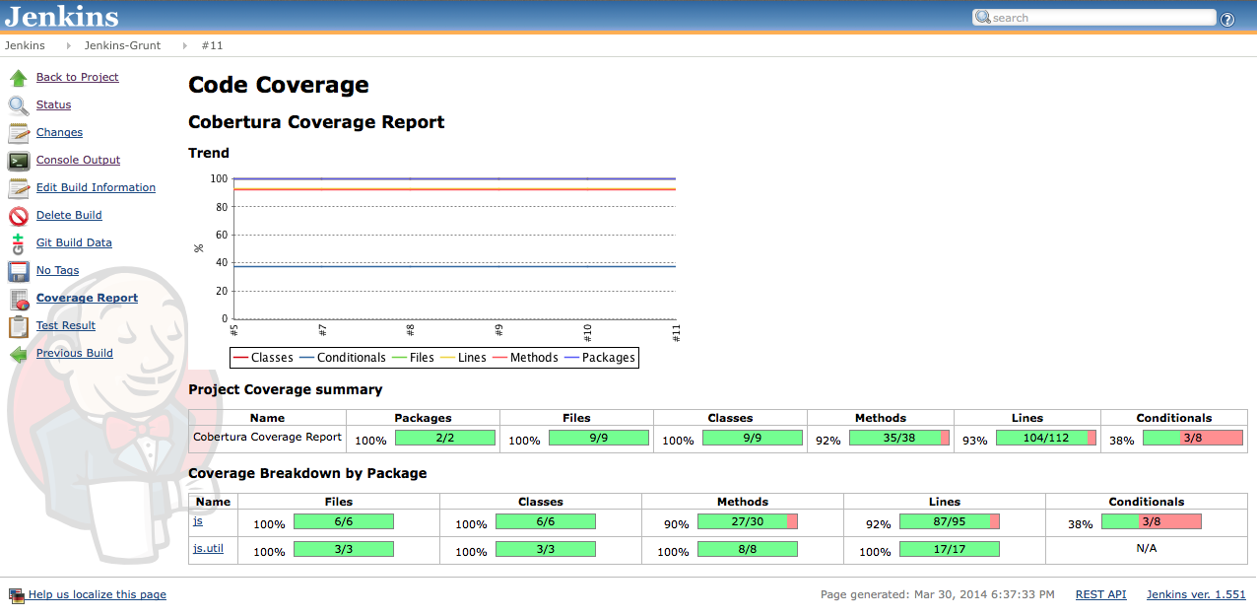
CI Phases | Code Coverage
Notes:
Ask people what do they understand from Code Coverage, what all metrices they get in code coverage
Talk about the audit scenario where a team had a complete different understanding of code coverage due to the misunderstanding of metrices

Slide 7
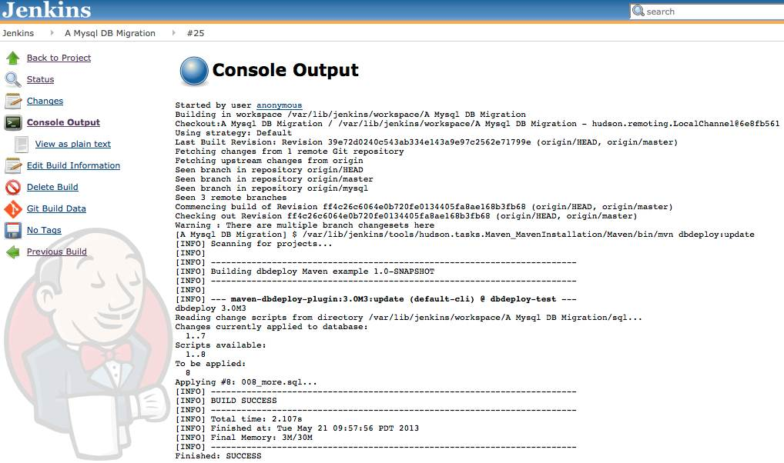
CI Phase | DB Update
Notes:
Maven db deploy plugin
Need to manually create changelog file

Slide 8
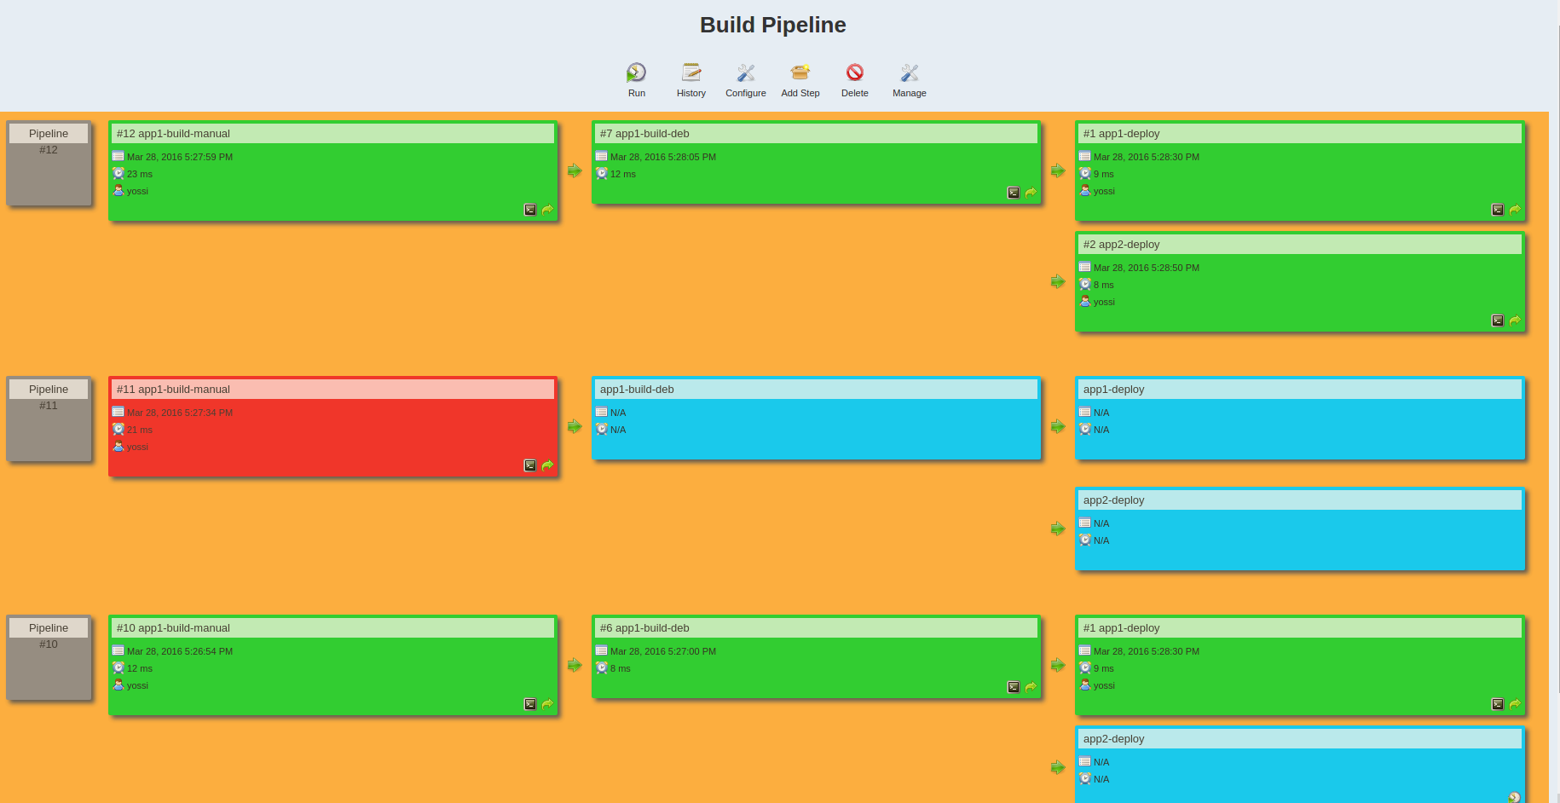
CI Phases | DevIntegration Deployment
Notes:
Ask people how do they deploy there code
Talk about various strategies to do deployment
Normal Deployment
Why ansible is a good option instead of a bash scripting

Slide 9
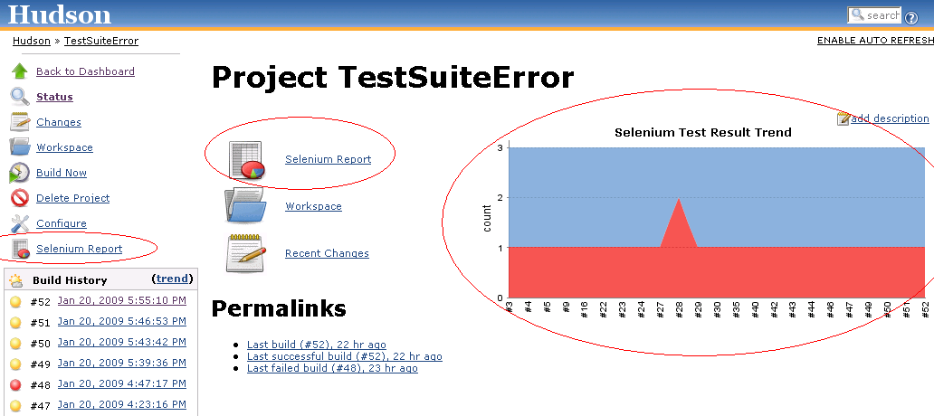
CI Phases | UI/API Testing
Notes:
Why it becomes important to have UI tests part of CI

Slide 10
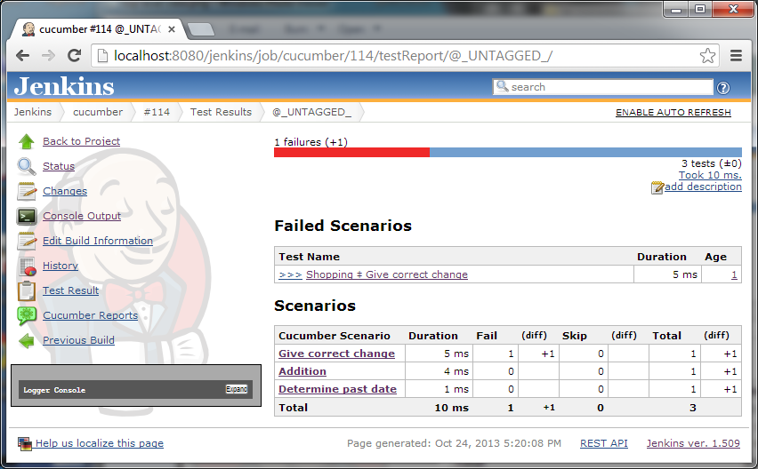
CI Phases | UI/API Testing
Notes:
Why you should have a benchmark of 90%+ for the API tests

Slide 11
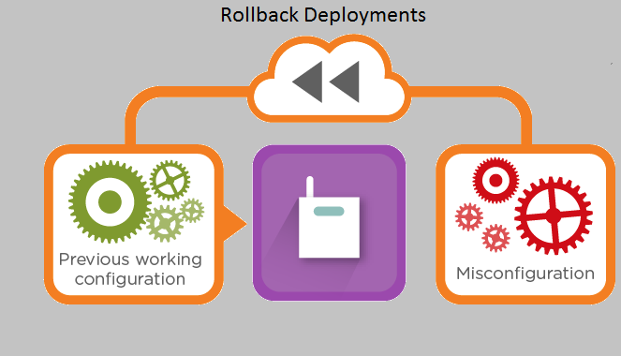
CI Phases | Rollback
Notes:
Talk about Green Blue Deployment

Slide 12
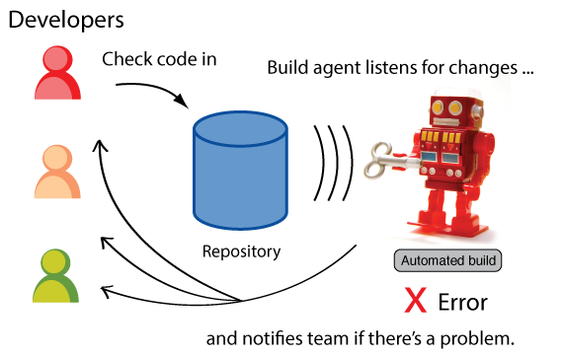
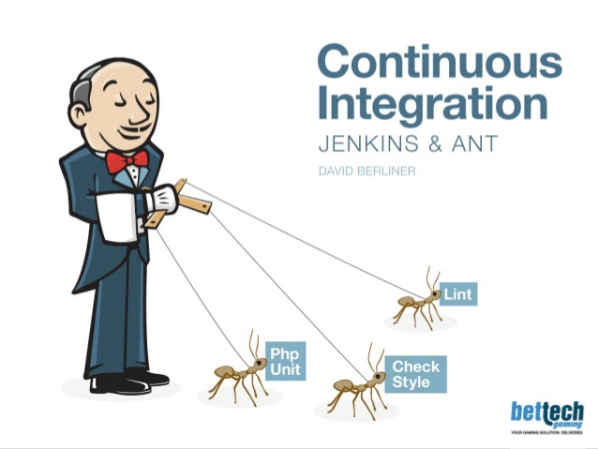
What is Continuous Integration
This is the process of continuously integrating fresh code with the previous code and test it over different predefined custom testing rules to identify issues that will hurt in production.

Slide 13
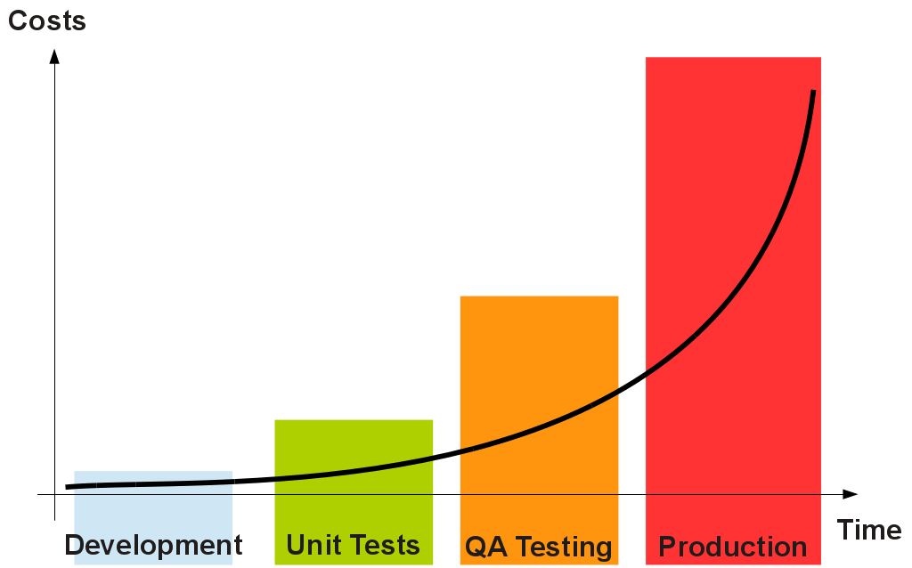
Why CI
Notes:
Discussion about cost
Run your tests in the real world
Increase your code coverage
Deploy your code to production with full confidence
Build stuff faster
Decrease code review time.
Spend less time debugging and more time adding features
Reduce integration problems allowing you to deliver software more rapidly

Slide 14



What is not ?
Continuous Compilation
Continuous Integration

Slide 15

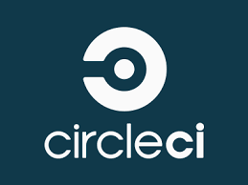






Tooling Landscape

Slide 16
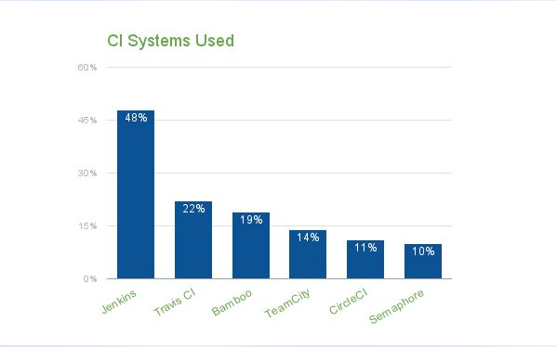
Notes:
Bitnami Survey
https://blog.1and1.com/2016/08/11/continuous-integration-trends-from-bitnamis-user-survey/

Slide 17

Jenkins
Jenkins is an extensible continuous integration server. This is open-source CI server which is very easy to install and use. Have a great GUI to handle.
Jenkins is:
Written in Java
Initially was supposed to be used as a CI tool
Over 600 plugins to customize Jenkins as per your need
Over 1000+ public repositories on Github,
500+ contributors, strong commit activity
Free open source and most widely used tool for maintaining continuous integration cycle.
Notes:
Easy install, easy upgrade, easy configuration
Distributed builds – Arguably most powerful feature.
Monitoring external jobs
No limit to the number of jobs, number of slave nodes
Plugin architecture: Support for various version control systems, authentication methods, notification, workflow building, and many more features can be added.
Jenkins provides machine-consumable remote access API to its functionalities
Actually there are lot of useful plugins. The list is too long to mention here. Go on, explore on your own. There’s plugin available for almost everything you would want.

Slide 18

Demo using Jenkins
Create jobs for testing
Code stability job
Code coverage job
Code quality job
Static code analysis job
Unit test job
Report publishing
Artifact upload using nexus

Slide 19
Advanced Topics
Exploring various plugins
Authentication
Authorization
Master Slave setup
Pipelines
Backup & restore
…..

Slide 20

Questions ?

